Slide 1
Internship studio- ethical hacking- project
Task 1
Solve 5 labs on portswigger.com

Slide 2
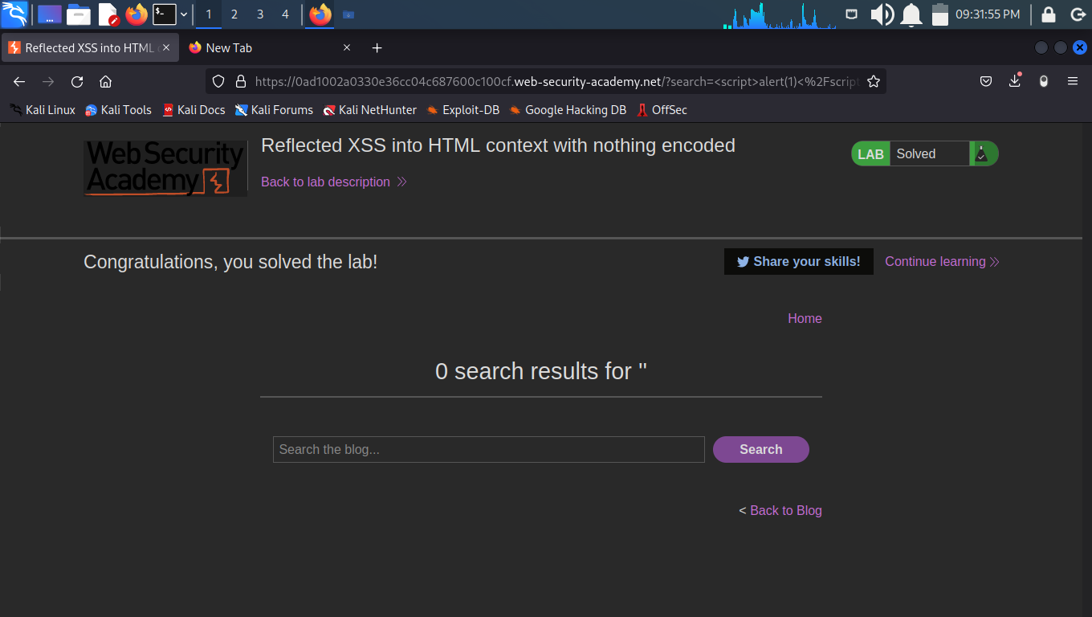
lab-1

Slide 3
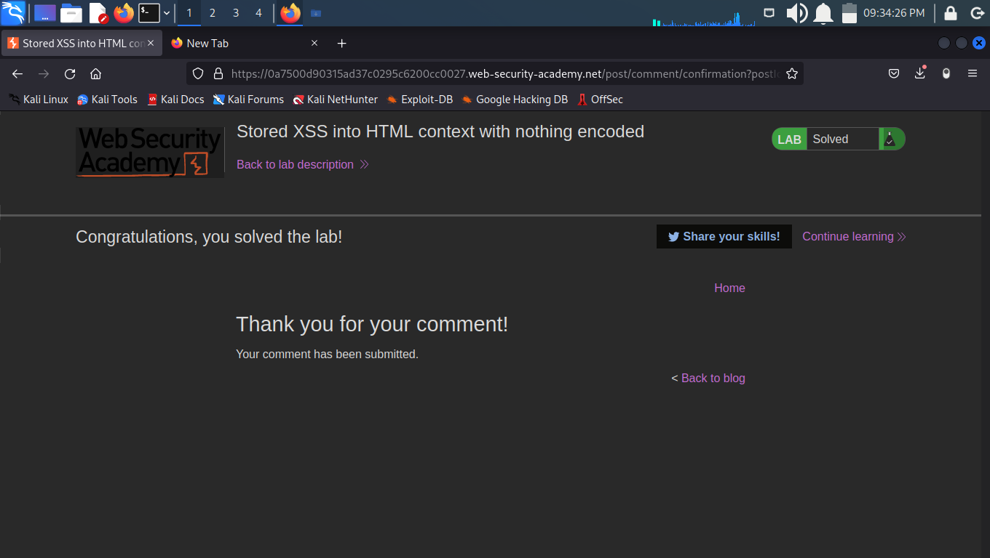
Lab-2

Slide 4
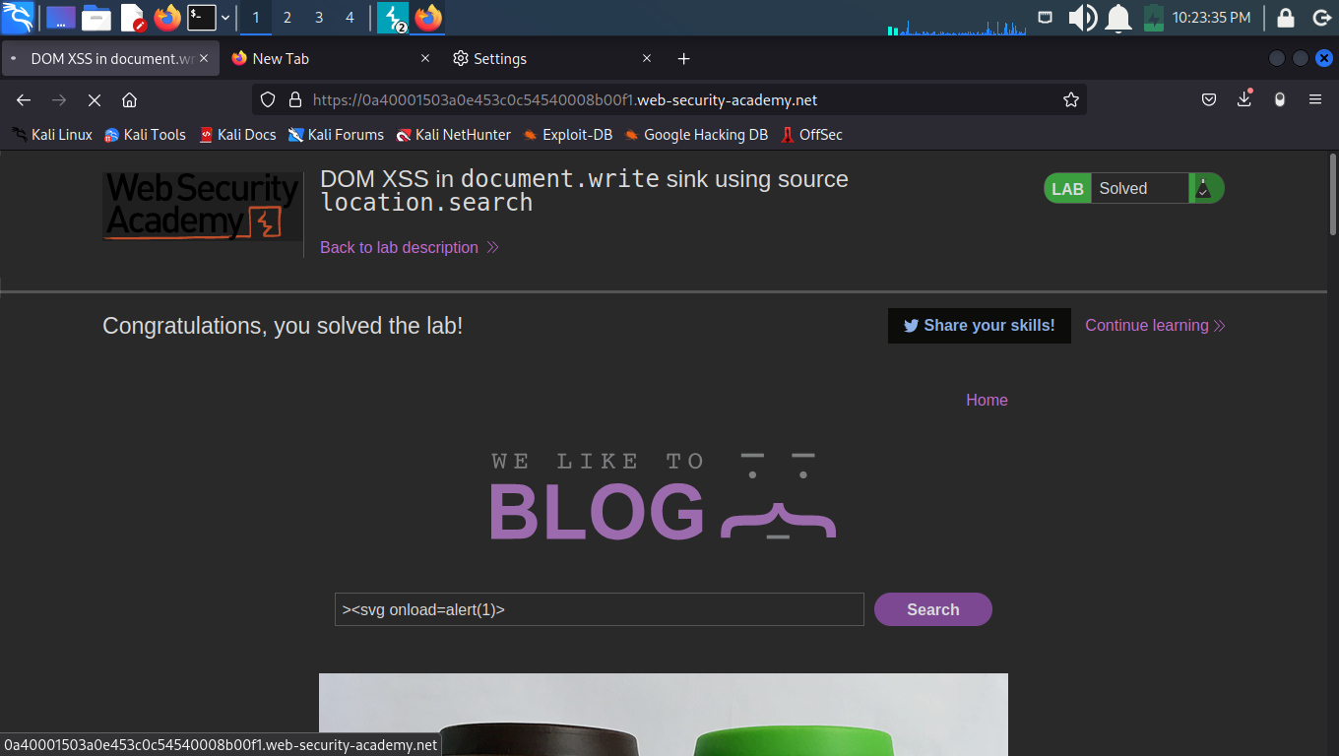
Lab-3

Slide 5
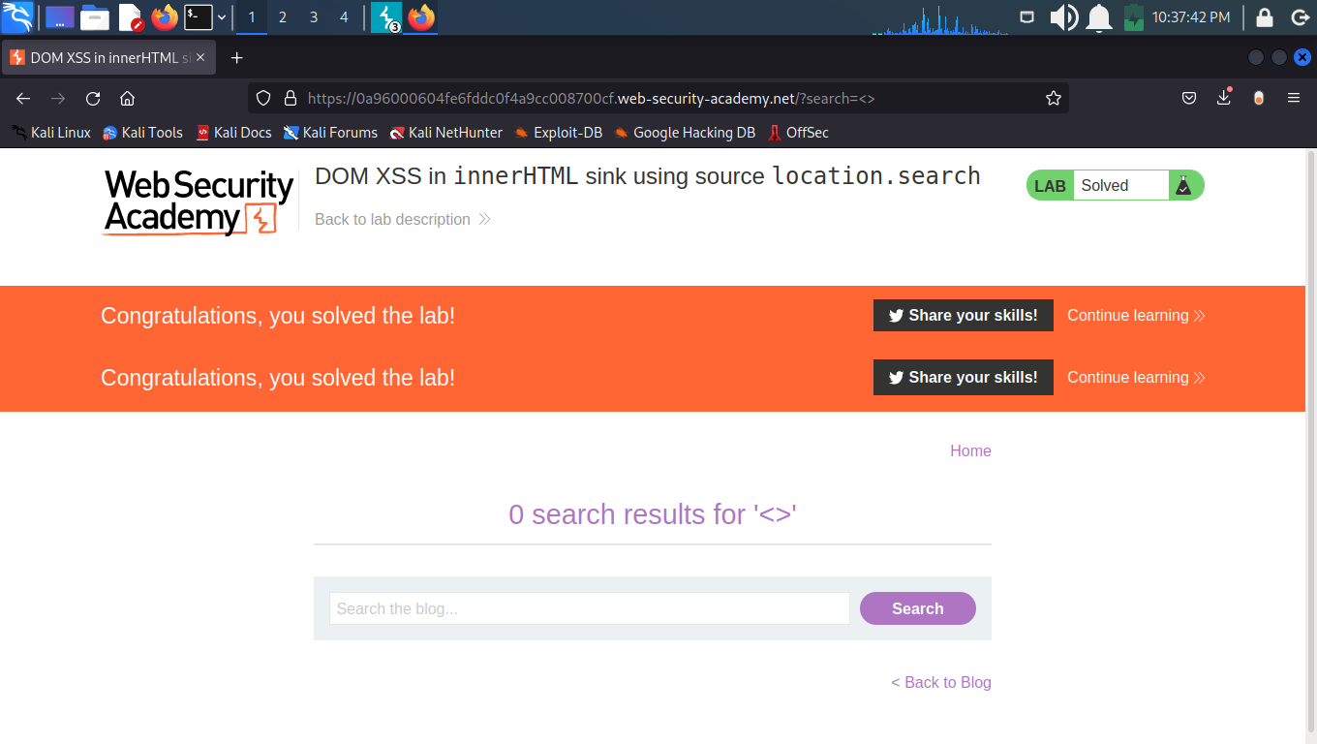
lab-4

Slide 6
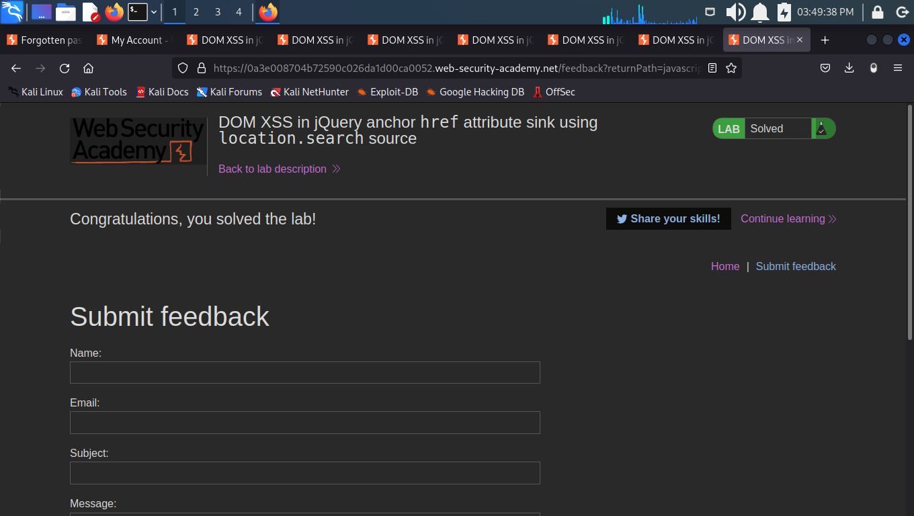
Lab-5

Slide 7
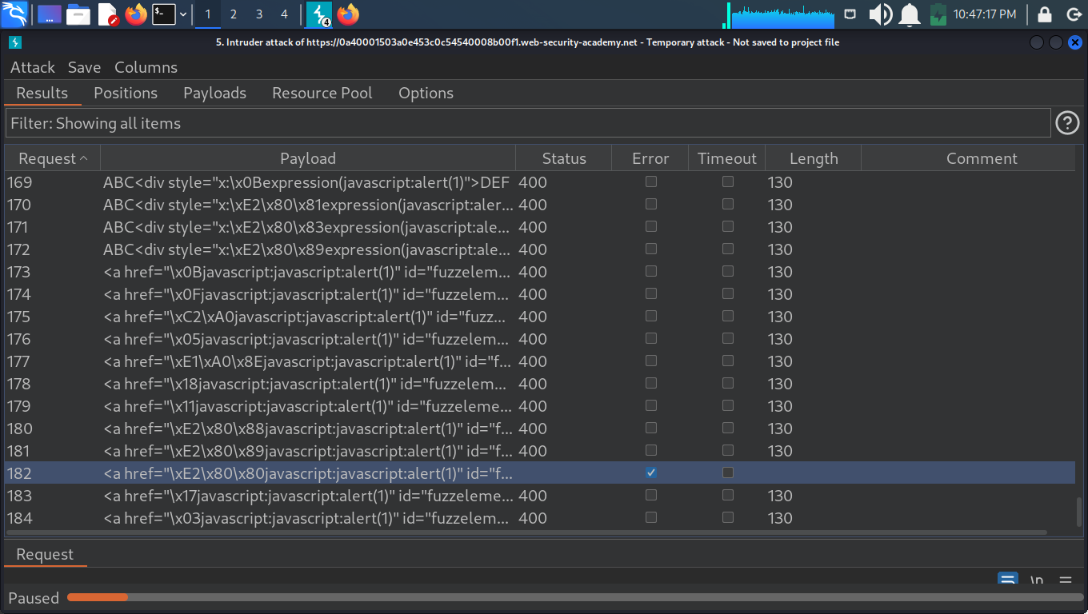
Scanning for vulnerabilities through burpsuite

Slide 8
Thank you
By Nivedita Shaw
gmail: iamnivie@gmail.com

